Slide 1
I just want the truth!

Slide 2
Recap (Session 3)

Slide 3
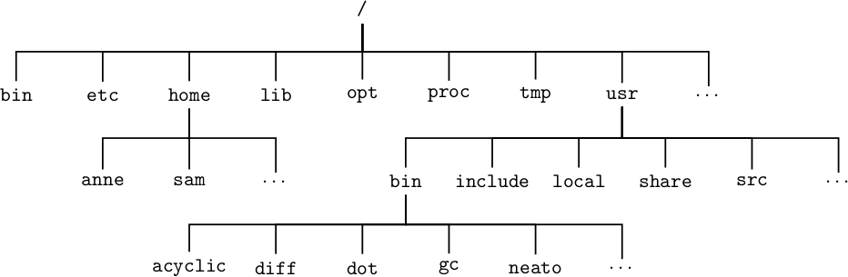
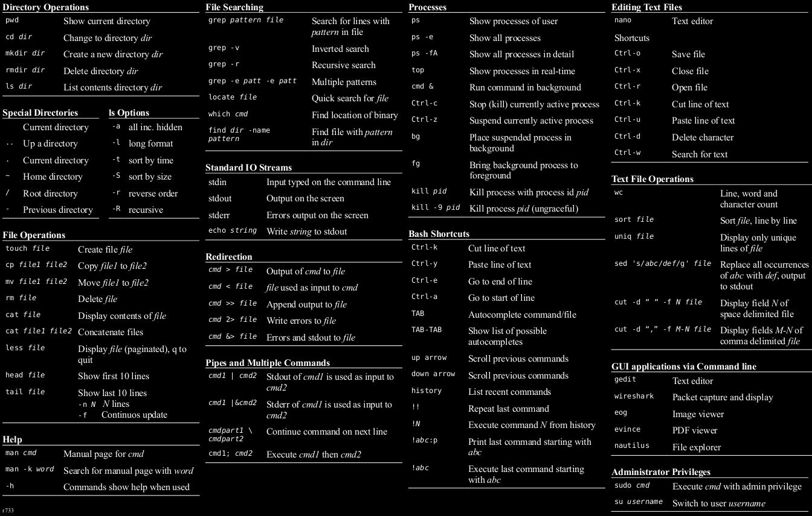
I ‘Shell” be happy
/home/anne
/var/www/html/
recap
In the text terminal, everything is logically structured!
cat flag.txt
cd anne
cd /home/anne

Slide 4
Summary
Most servers operate in Command Line Interface
Command line tools are cool! But not with Web!
The limit to web features is the developer’s creative mind, but the limit to loopholes is the developer’s careless mind!
Google is your best friend for commands! ☺

Slide 5
SQL INJECTION
Session 4

Slide 6
Let’s warm up
Given the commands:
See the board!
Lets have it in English:
I want to SELECT ALL data
I tell the database to give me data
The database replies with all the data I wanted

Slide 7
Structured Query Language
Lets you access and manipulate databases.
Access what you want, whenever you execute it.
Hackers love playing with SQL. (Think data leakage)

Slide 8
Structured Query Language
Network
(Internet)
Website
www service
Apache/Nginx
Database
Etc…
Router
Server

Slide 9
Structured Query Language
users
Database:
School
No | Username | Password
1 | Admin | AdminPassword
2 | User | UserPassword
.. | .. | ..

Slide 10
Structured Query Language
The SELECT statement
SELECT [column(s) / *] FROM [origin]
SELECT Username,Password FROM users
SELECT * FROM users

Slide 11
Structured Query Language
SELECT Username, Password FROM users
users
Database:
School
No | Username | Password
1 | Admin | AdminPassword
2 | User | UserPassword
.. | .. | ..

Slide 12
Structured Query Language
SELECT Username, Password FROM users
0
1
[ [ Admin , AdminPassword ] , [ User , UserPassword ] ]
0
1
0
1
No | Username | Password
1 | Admin | AdminPassword
2 | User | UserPassword
.. | .. | ..

Slide 13
Structured Query Language
SELECT Username, Password FROM users
0
1
[ [ Admin , AdminPassword ] , [ User , UserPassword ] ]
0
1
0
1
No | Username | Password
1 | Admin | AdminPassword
2 | User | UserPassword
.. | .. | ..

Slide 14
Structured Query Language
SELECT Username, Password FROM users
0
1
[ [ Admin , AdminPassword ] , [ User , UserPassword ] ]
0
1
0
1
No | Username | Password
1 | Admin | AdminPassword
2 | User | UserPassword
.. | .. | ..

Slide 15
Structured Query Language
SELECT Username, Password FROM users
0
1
[ [ Admin , AdminPassword ] , [ User , UserPassword ] ]
0
1
0
1
No | Username | Password
1 | Admin | AdminPassword
2 | User | UserPassword
.. | .. | ..

Slide 16
Structured Query Language
SELECT Username, Password FROM users
0
1
[ [ Admin , AdminPassword ] , [ User , UserPassword ] ]
0
1
0
1
No | Username | Password
1 | Admin | AdminPassword
2 | User | UserPassword
.. | .. | ..

Slide 17
Structured Query Language
What does it mean to you?
Knowing how website works is essential in modelling an attack
“How does the website retrieve its data?”
“How does it pass on data?”
Most importantly: “Are there any weaknesses?”

Slide 18
Structured Query Language
The basics
In SQL, a ‘ # ’ means comment, and a ‘ ; ’ means end of line.
SELECT * FROM users; ##

Slide 19
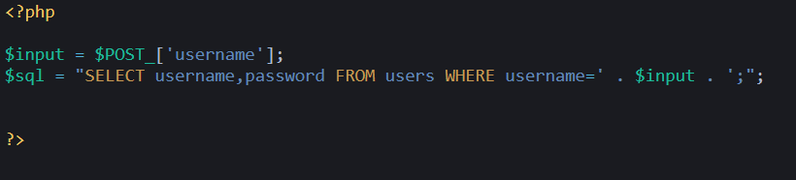
Structured Query Language
‘ OR 1=‘1;##
‘ OR 1=‘1;##
The most common SQL injection test statement
What if I input ‘ OR 1=‘1;## into this statement?

Slide 20
Structured Query Language
‘ OR 1=‘1;##
$input = ‘ OR 1=‘1;##
The most common SQL injection test statement
SELECT username,password FROM users WHERE username=' . $input . ';
What if I input ‘ OR 1=‘1;## into this statement?

Slide 21
Structured Query Language
‘ OR 1=‘1;##
SQL sent to database:
The most common SQL injection test statement
SELECT username,password FROM users WHERE username=‘’ OR 1=‘1;##
What if I input ‘ OR 1=‘1;## into this statement?

Slide 22
Structured Query Language
‘ OR 1=‘1;##
SQL sent to database:
The most common SQL injection test statement
SELECT username,password FROM users WHERE username=‘’ OR 1=‘1;##
This phenomenon is called ‘SQL INJECTION’

Slide 23
Structured Query Language
SQL INJECTION
‘injecting’ inputs to the web application which causes it to perform a different task
A very dangerous vulnerability as it could lead to a total system compromise.

Slide 24
Structured Query Language
Common Injection inputs
States that the statement will always be true. OR 1=1.
Where the ‘ OR ‘ operator will result true if either conditions are met.
‘ OR 1=‘1;##
Condition to be met

Slide 25
Structured Query Language
Common Injection inputs
‘ OR 1=‘1;##
‘ OR 1=‘1 LIMIT 1;##
‘ OR 1=‘1 ORDER BY [number];##
Sort the output by the column index.
Usually alphanumerical sorting.
This is usually used for Enumeration

Slide 26
Structured Query Language
Common Injection inputs
‘ OR 1=1 UNION SELECT <statements>
Output
UNION
Joins the first select with a second select statement. Second output is in constraint with first statement.
Normally works with SELECT statements in front.
Statement 1 output
Statement 2 output

Slide 27
Structured Query Language
SQL INJECTION
Practice makes perfect. Do not worry!
Here is a cheat sheet for you!
https://goo.gl/BFXDMv
Pentest Monkey MySQL SQLi cheatsheet

Slide 28
Hands On
Some fun?

Slide 29
Let’s warm up
Go to this website:
https://www.w3schools.com/sql/trysql.asp?filename=trysql_op_in
Notes:
ShipperName
SupplierName

Slide 30
This week’s theme
SQL INJECTION

Slide 31
Summary of the CTF workshop ☺
Week 2 – Misc Challenges & Intro to CTF
Week 3 – Basic web theories
Week 4 – Command Injection
Week 5 – SQL injection
eLearn Week 6 – Basic Cryptography (No challenge, just knowledge)

Slide 32
What’s Next?
WINTER BREAK!
RED TEAM BOOT CAMP

Slide 33
Thank you
I hope you had fun!

